Slide 1
End-to-end Automatic Speech Recognition Part1 (CTC and Decoding)
Wonyong Sung
Signal Processing Systems Lab @ SNU

Slide 2
Contents
End-to-end speech recognition 개요
CTC algorithm
Overview
Training
Tensorflow Implementation
Decoding
CTC Implementation Examples
DeepSpeech2
CTC Gram
CTC Word
CTC on FPGA

Slide 3
기존 음성인식 – Many Components Integration (확률모델)
마이크
신호분석
음향모델 (AM)
Hidden Markov Model
사전 (Lexicon)
Search
Space
인식결과
훈련
데이터
언어모델 (LM)
신호분석 – 음성을 주파수 성분으로 나눔 (time to frequency domain)
음향모델 – 음성을 음소 (phoneme) 단위로 분석
사전 – 어떤 단어의 발음 (음소의 연결)
언어모델 – 다음에 나올 단어를 예측 (perplexity를 줄임)
탐색 – 들어오는 발음을 세가지 모델에 맞추어서 가장 확률이 높은 연결을 찾음

Slide 4
End-to-end Speech Recognition
Name
음성을 인공신경망 모델에 넣으면 (중간과정 없이) 텍스트 (단어나 character)가 나옴
개념은 Image recognition 과 비슷
왜 speech 는 어려운가?
음성은 내부에 sub-structure 가 있다. (phoneme 의 복잡한 연결이 글자, 글자의 연결이 단어, 단어의 연결이 문장 등)
Segmentation problem 이 있다.
내부 structure 가 있는 문제 들: 번역, handwriting text recognition
Neural Network
Image
Text
Neural Network
Speech

Slide 5
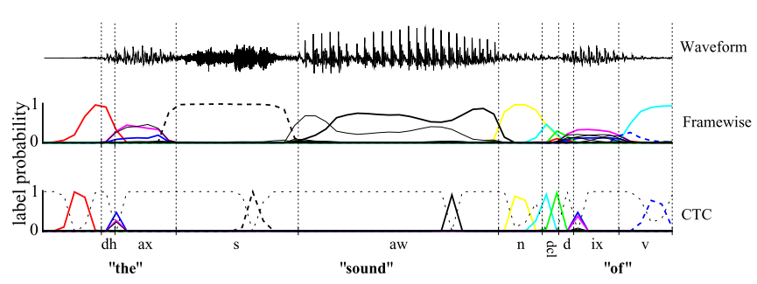
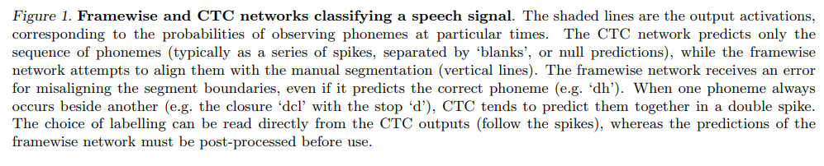
CTC algorithm
Graves

Slide 6
Acoustic modeling with CTC RNN
음성을 듣고서 발음으로 표시함. 이 때 표현하는 발음의 단위에 따라
Triphone states (매우 작은 시간 단위로 표현)
매우 안정된 주파수 특징을 보이기 때문에 인식이 쉽다.
이를 꾀어 맞추어서 단어와 문장으로 만들기가 복잡하다. 더 복잡한 hidden Markov model.
전체적으로 정확도 좋다.
Monophone (40~70개의 phoneme 으로 표현)
Grapheme (알파벳 글자로 표현) – 수십개, 1초에 몇번 나옴.
Wordpiece – 수백 ~ 수만
Word – 수십만 단어, 1초 정도의 시간

Slide 7
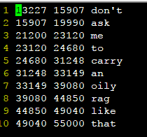
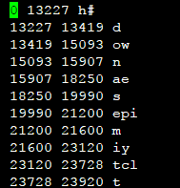
Why end-to-end?
Potentially better accuracy
Simpler architecture
Easy to collect the training data (speech file, text label)
No need to frame wise phoneme information

Slide 8
Part 1: CTC algorithm

Slide 9

RNN for sequence learning
Parameters to be learned:
U, V, W

Slide 10
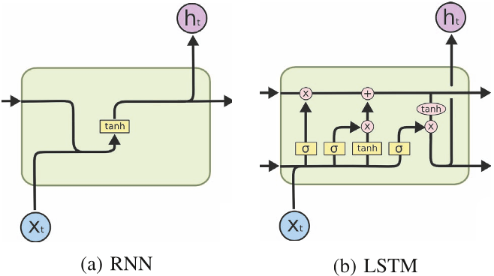
Simple RNN vs LSTM (Long Short Term Memory) RNN

Slide 11
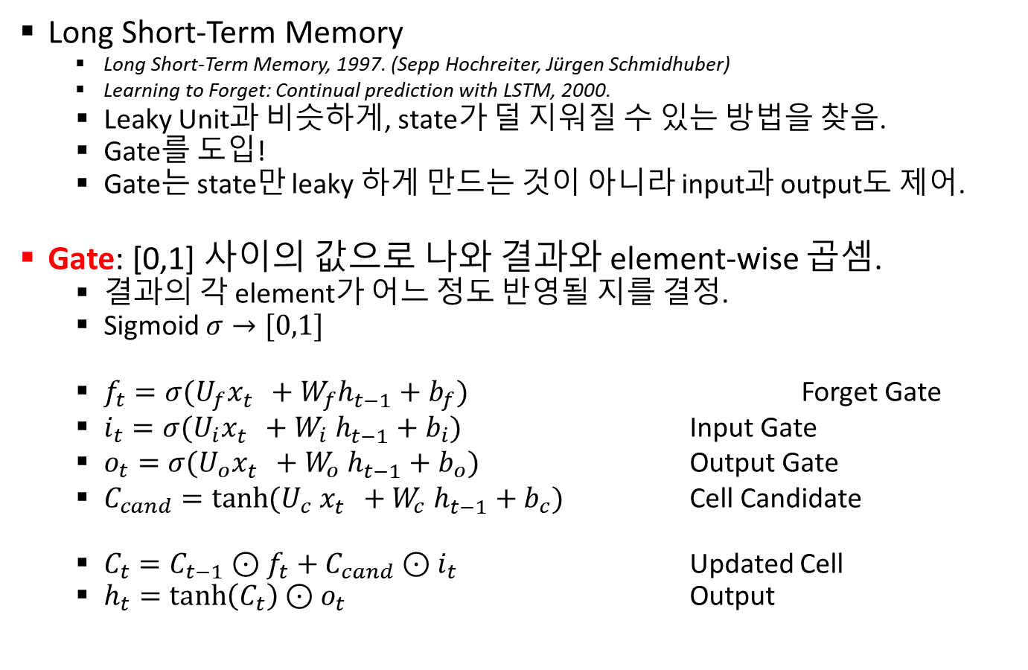
LSTM
Long Short-Term Memory
Long Short-Term Memory, 1997. (Sepp Hochreiter, Jürgen Schmidhuber)
Learning to Forget: Continual prediction with LSTM, 2000.
Leaky Unit과 비슷하게, state가 덜 지워질 수 있는 방법을 찾음.
Gate를 도입!
Gate는 state만 leaky 하게 만드는 것이 아니라 input과 output도 제어.
Gate: [0,1] 사이의 값으로 나와 결과와 element-wise 곱셈.
결과의 각 element가 어느 정도 반영될 지를 결정.
Sigmoid $σ→[0,1]$
$f_{t}=σ(U_{f}x_{t}^{}+{W_{f}h}_{t−1}^{}+b_{f})$ Forget Gate
$i_{t}=σ({U_{i}x}_{t}^{}+{W_{i} h}_{t−1}^{}+b_{i})$ Input Gate
$o_{t}=σ({U_{o}x}_{t}^{}+{W_{o} h}_{t−1}^{}+b_{o})$ Output Gate
$C_{cand}=\tanh{({U_{c} x}_{t}^{}+{W_{c} h}_{t−1}^{}+b_{c}) }$ Cell Candidate
$C_{t}=C_{t−1}⊙f_{t}+C_{cand}⊙i_{t}$ Updated Cell
$h_{t}=\tanh\left(C_{t}\right)⊙o_{t}$ Output

Slide 12
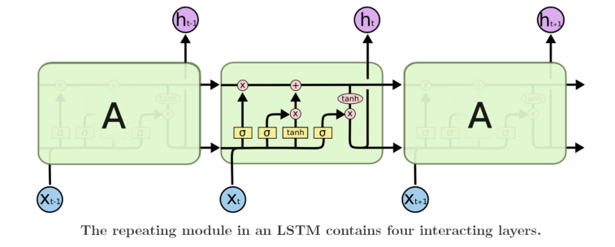

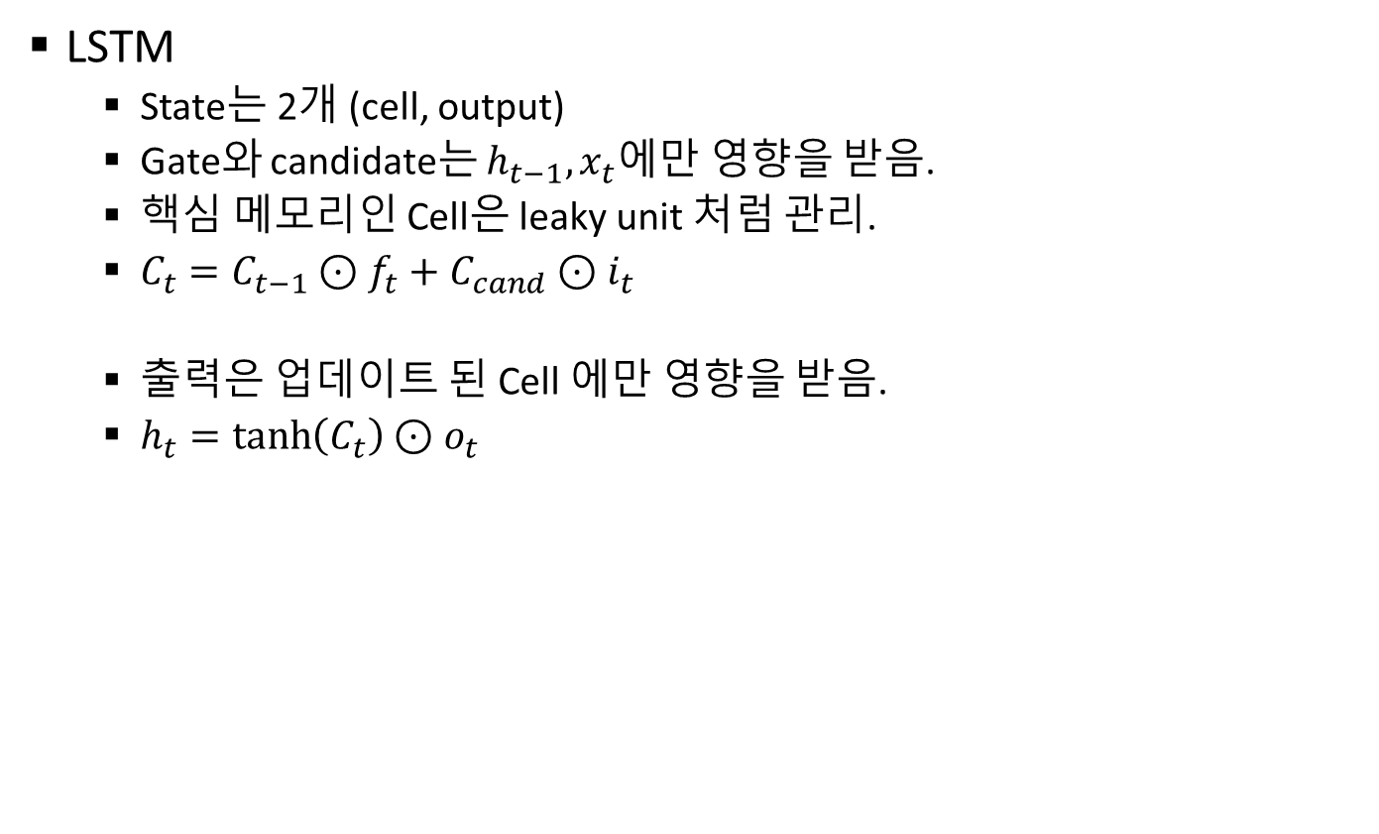
LSTM
LSTM
State는 2개 (cell, output)
Gate와 candidate는 $h_{t−1}, x_{t}$에만 영향을 받음.
핵심 메모리인 Cell은 leaky unit 처럼 관리.
$C_{t}=C_{t−1}⊙f_{t}+C_{cand}⊙i_{t}$
출력은 업데이트 된 Cell 에만 영향을 받음.
$h_{t}=\tanh\left(C_{t}\right)⊙o_{t}$

Slide 13
Speech recognition with RNN
RNN: Sequence data를 처리하기 적합
Text data -> language model
Speech data -> acoustic model
Acoustic model : T 개의의 입력 -> N 개의 출력
T : # of sampled speech feature
N : # of text sequence( # of character, # of phone, …)
일반적으로, T>>N
몇 번째 step에서 출력을 얻을 것인 지 알아야 한다.
H
I
<sil>
M
time

Slide 14
CTC algorithm
Connectionist Temporal Classification
Connectionist Temporal Classification : Labelling Unsegmented Sequence Data with Recurrent Neural Networks, 2006 ICML.
시간 축에서의 classification을 neural network로 해결
Feature : frame sequence
Label : text sequence: {a, b, c, : : : , z, space, apostrophe, blank}
Input과 output의 sequence 길이가 다른 문제점을 blank label 을 넣어서 해결!
Data labeling이 훨씬 간단해진다.

Slide 15
CTC algorithm
How?
Output 의 sequence길이를 늘려서 frame sequence 길이와 같게 만든다.
Temporal classification을 위해 blank 라벨을 추가
Example
Label : ABCD (4)
Expanded CTC path : __A__BBBB____CD___ (13)
Blank는 실제 label과는 관련이 없다.
연속된 expanded label은 하나의 label로 처리된다
실제 label이 연속된 같은 값을 가지는 경우 blank로 구분
ABBC -> __A___BBB_BB____C

Slide 16
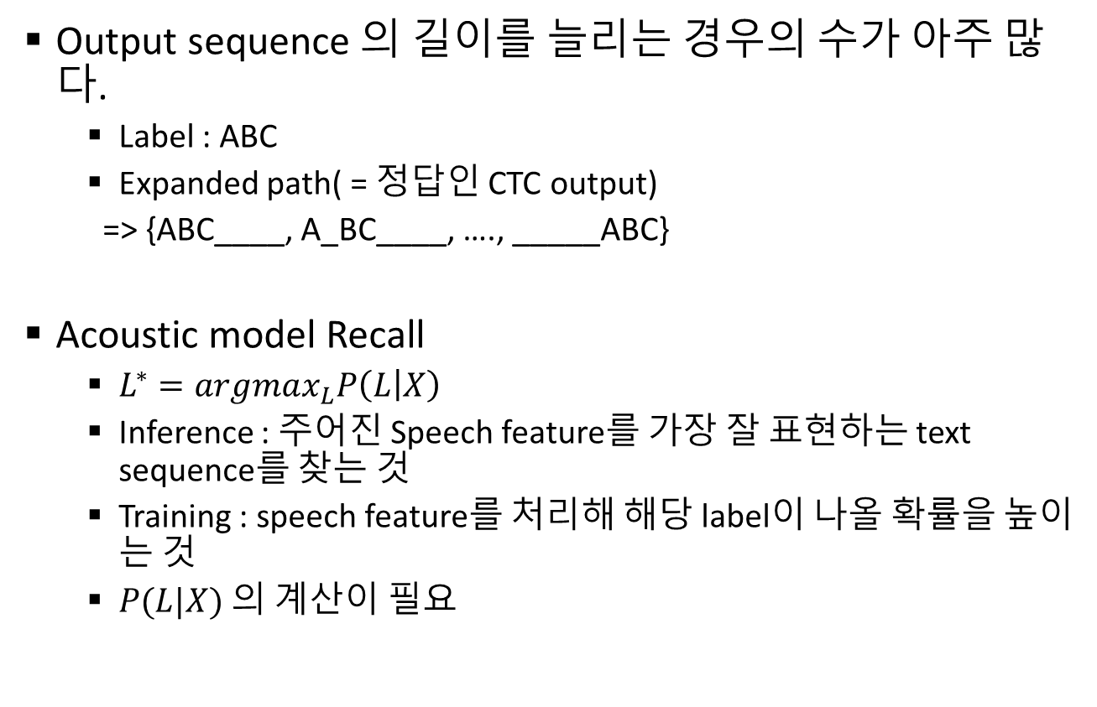
CTC algorithm
Output sequence 의 길이를 늘리는 경우의 수가 아주 많다.
Label : ABC
Expanded path( = 정답인 CTC output)
=> {ABC____, A_BC____, …., _____ABC}
Acoustic model Recall
$L^{∗}=argmax_{L}P\left(L | X\right)$
Inference : 주어진 Speech feature를 가장 잘 표현하는 text sequence를 찾는 것
Training : speech feature를 처리해 해당 label이 나올 확률을 높이는 것
$P(L|X)$ 의 계산이 필요

Slide 17
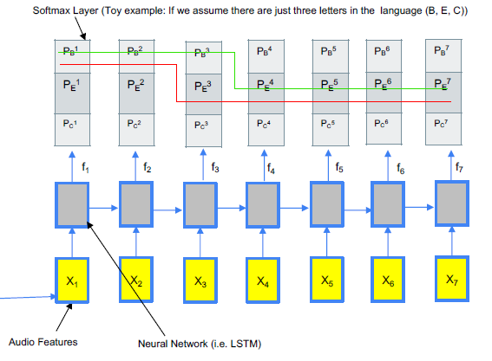
Sequence learning problem
어느 한 순간이 아닌 전체 경로에서의 확률값이 가장 높아야 한다.

Slide 18
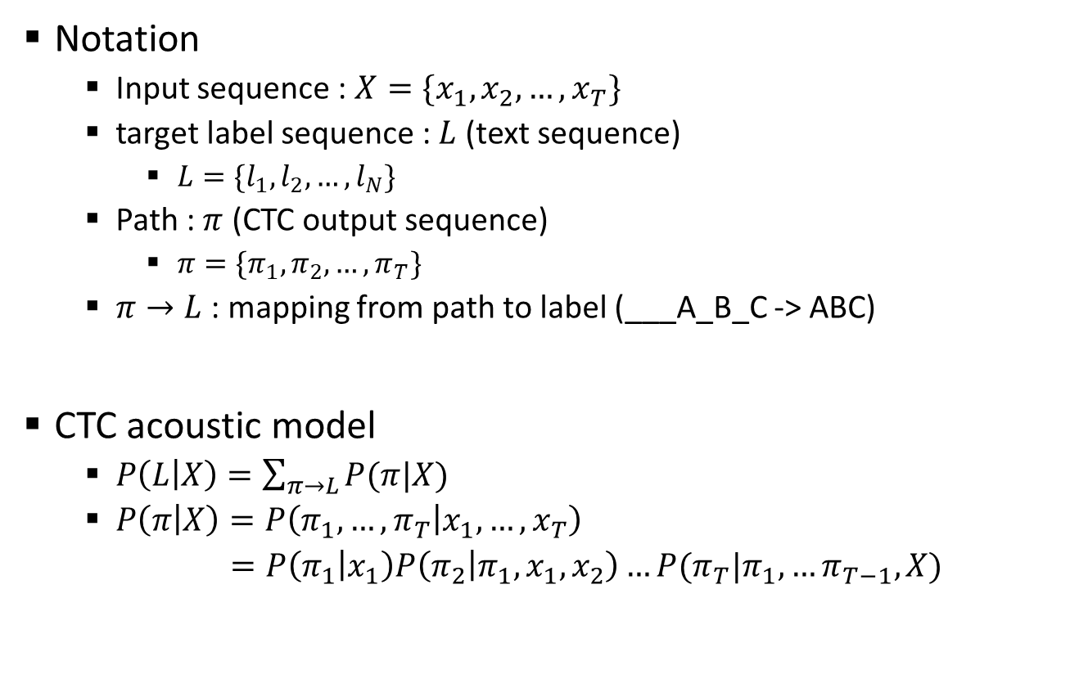
CTC algorithm
Notation
Input sequence : $X=\{x_{1}, x_{2},…,x_{T}\}$
target label sequence : $L$ (text sequence)
$L=\{l_{1},l_{2},…, l_{N}\}$
Path : $π$ (CTC output sequence)
$π=\{π_{1},π_{2},…, π_{T}\}$
$π→L$ : mapping from path to label (___A_B_C -> ABC)
CTC acoustic model
$P\left(L | X\right)=\sum_{π→L}{P(π|X)}$
$P\left(π | X\right)=P\left(π_{1},…, π_{T} | x_{1},…,x_{T}\right)$
$=P\left(π_{1} | x_{1}\right)P\left(π_{2} | π_{1},x_{1},x_{2}\right)…P(π_{T}|π_{1},…π_{T−1}, X)$

Slide 19
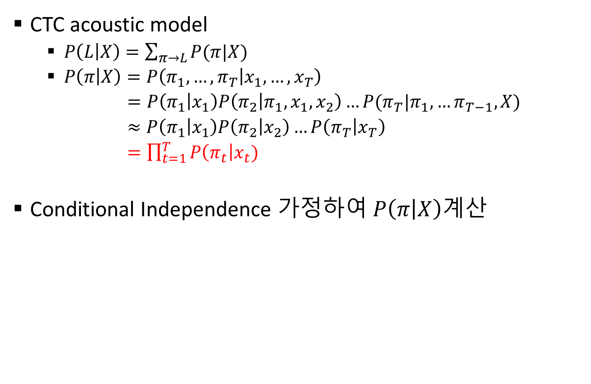
CTC algorithm
CTC acoustic model
$P\left(L | X\right)=\sum_{π→L}{P(π|X)}$
$P\left(π | X\right)=P\left(π_{1},…, π_{T} | x_{1},…,x_{T}\right)$
$=P\left(π_{1} | x_{1}\right)P\left(π_{2} | π_{1},x_{1},x_{2}\right)…P(π_{T}|π_{1},…π_{T−1}, X)$
$≈P\left(π_{1} | x_{1}\right)P\left(π_{2} | x_{2}\right)…P\left(π_{T} | x_{T}\right)$
$=\prod_{t=1}^{T}{P\left(π_{t}\right|x_{t})}$
Conditional Independence 가정하여 $P\left(π | X\right)$계산

Slide 20
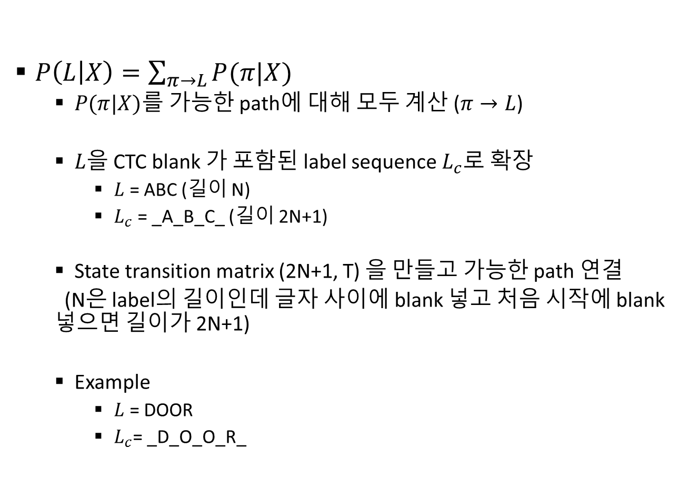
CTC algorithm
$P\left(L | X\right)=\sum_{π→L}{P(π|X)}$
$P(π|X)$를 가능한 path에 대해 모두 계산 ($π→L$)
$L$을 CTC blank 가 포함된 label sequence $L_{c}$로 확장
$L$ = ABC (길이 N)
$L_{c}$ = _A_B_C_ (길이 2N+1)
State transition matrix (2N+1, T) 을 만들고 가능한 path 연결
(N은 label의 길이인데 글자 사이에 blank 넣고 처음 시작에 blank 넣으면 길이가 2N+1)
Example
$L$ = DOOR
$L_{c}$= _D_O_O_R_

Slide 21
Sequence output 의 제약조건
State는 blank 를 포함한 character (a, b, …., z, space, apostrophe, blank 등)
t -> t+1 로 갈 때
같은 state 에 머무를 수 있다.
Non-blank 에서 다음의 blank 로 갈 수 있다.
Blank 에서 다음의 non-blank 로 갈 수 있다.

Slide 22
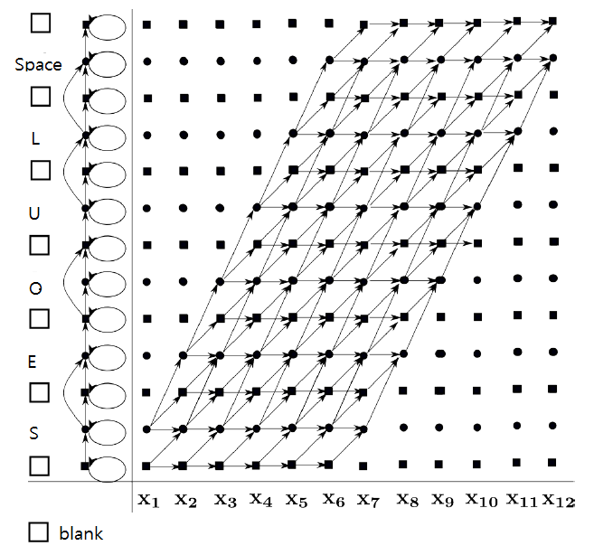
CTC state transition 의 예
2N+1 state

Slide 23
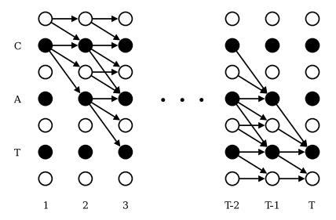
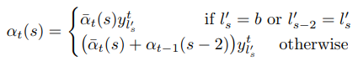
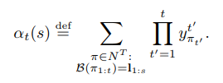
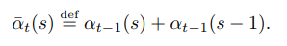
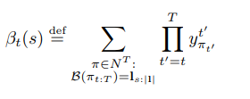
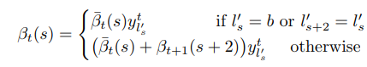
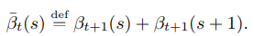
CTC algorithm
State transition 확률을 동일하게 가정
Connectionist Temporal Classification: Labelling Unsegmented Sequence Data with RNNs, 2006 ICML.

Slide 24
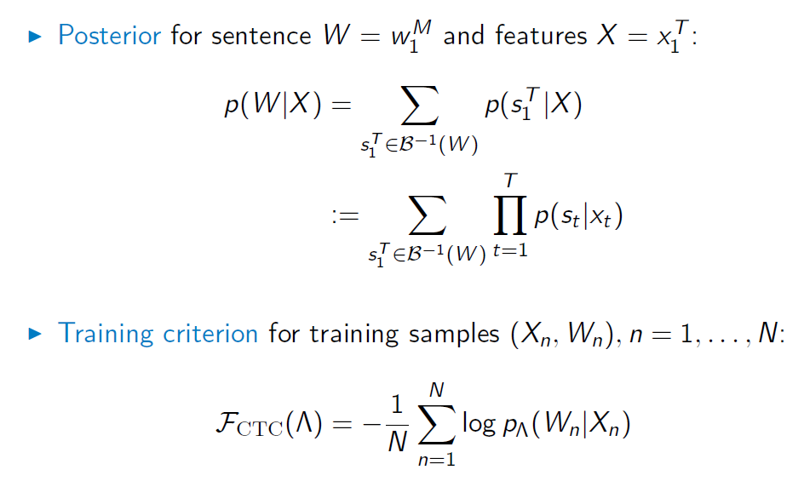
Connectionist Temporal Classification

Slide 25
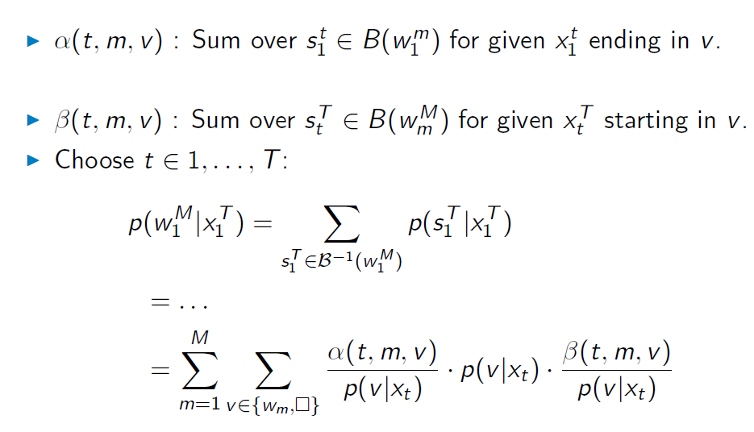
Forward-Backward Decomposition

Slide 26
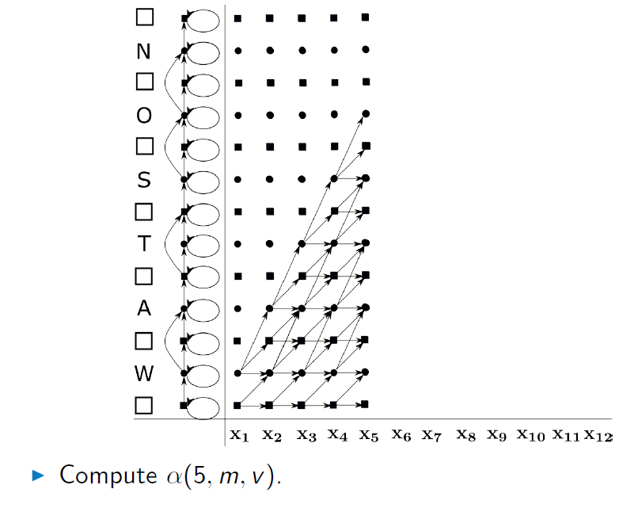
Forward Algorithm

Slide 27
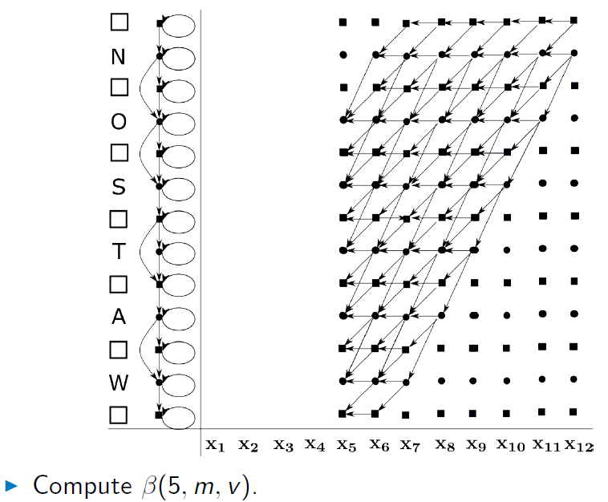
Backward Algorithm

Slide 28
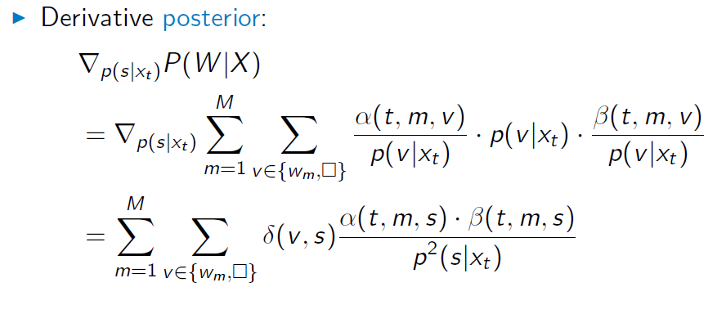
CTC Derivatives

Slide 29
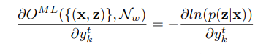
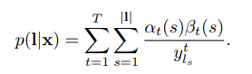
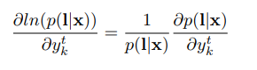
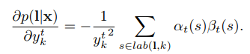

Slide 30
CTC Training of Long Speech Input
일반적 CTC 훈련용 input 의 길이는 짧다 (10초 이내). 실제로 소리가 긴 상황에서 잘 동작?
긴 소리로 훈련을 시킴. Partial windowing
짧은 소리로 훈련시켜도 긴 소리 잘 인식 (Encoder-Decoder 모델에서는 이 문제 때문에 LAS가 나옴)
Hwang, Kyuyeon, and Wonyong Sung. "Sequence to sequence training of ctc-rnns with partial windowing." International Conference on Machine Learning. 2016.

Slide 31
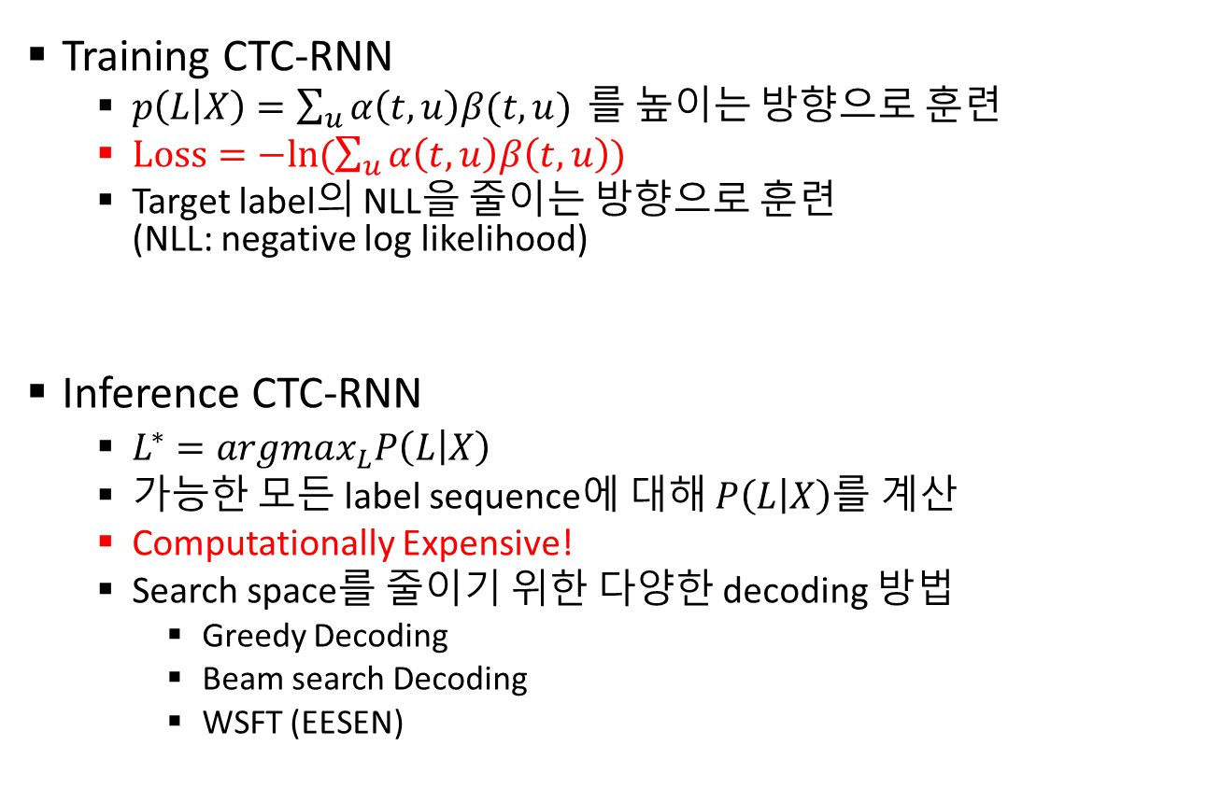
CTC algorithm
Training CTC-RNN
$p\left(L | X\right)=\sum_{u}{α\left(t,u\right)β(t,u)}$ 를 높이는 방향으로 훈련
$Loss=−ln(\sum_{u}{α\left(t,u\right)β\left(t,u\right)})$
Target label의 NLL을 줄이는 방향으로 훈련 (NLL: negative log likelihood)
Inference CTC-RNN
$L^{∗}=argmax_{L}P\left(L | X\right)$
가능한 모든 label sequence에 대해 $P\left(L | X\right)$를 계산
Computationally Expensive!
Search space를 줄이기 위한 다양한 decoding 방법
Greedy Decoding
Beam search Decoding
WSFT (EESEN)

Slide 32
Tensorflow CTC-RNN
Training
Tensorflow에는 CTC_Loss라는 함수가 존재
Dynamic programming이 미리 되어있다.
Loss = Tf.ctc_loss(logit, y) 한 줄로 처리 가능!
Logit shape : (N_batch, N_seq, n_class + 1)
Y(label) shape : sparse tensor
Sparse tensor
(Sparse indices, sparse values, sparse shape)로 구성
0 | 2 | 0
0 | 0 | -1
0 | 0 | 0
Sparse indices : [[0,1],[1,2]]
Sparse values : [2, -1]
Sparse shape : [3,3]

Slide 33
Tensorflow CTC-RNN
Training
원래 label shape : character sequence -> (n_batch, sentence length)
원하는 label shape : (n_batch, n_seq)
보통 n_seq > sentence length (recall T>>N)
Sparse shape : (n_batch, n_seq) 인 sparse tensor type으로 원래 label을 바꿔줘야 한다.
Training 시 tf.sparse_place_holder() 를 활용
Learning rate에 따라 초반에 Nan이 뜰 수 있다.
훈련이 잘 안된 초기에는 확률 값이 매우 낮음
NLL -> Inf 가 나와 문제가 생길 수 있음
자주 발생한다면 hyper parameter tuning이 필요
가끔 발생한다면 roll back

Slide 34
Tensorflow CTC-RNN
Training
Curriculum learning
Sequence가 짧은 speech가 상대적으로 쉽다.
짧은 data로 먼저 훈련을 시킨 뒤 점차 긴 data를 학습한다.
Early-stopping & learning rate decay
Training data overfitting을 방지
Validation 결과를 보고 overfitting이 예상되면 learning rate를 낮춰 더 작은 범위를 탐색한다.
Best model의 parameter들을 매번 저장하며 진행

Slide 35
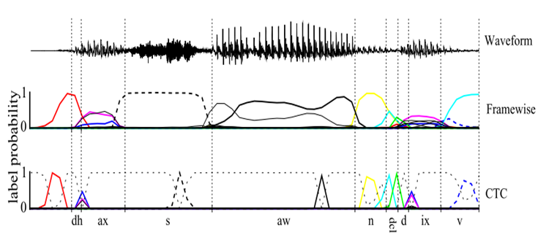
CTC Decoding
Graves

Slide 36
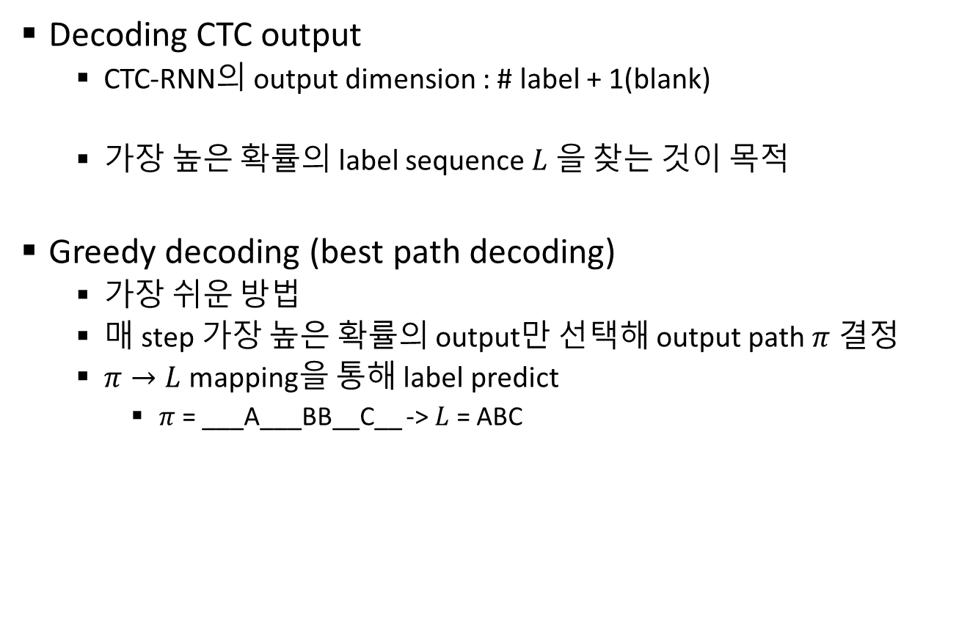
CTC Decoding
Decoding CTC output
CTC-RNN의 output dimension : # label + 1(blank)
가장 높은 확률의 label sequence $L$ 을 찾는 것이 목적
Greedy decoding (best path decoding)
가장 쉬운 방법
매 step 가장 높은 확률의 output만 선택해 output path $π$ 결정
$π→L$ mapping을 통해 label predict
$π$ = ___A___BB__C__ -> $L$ = ABC

Slide 37
Greedy Decoding

Slide 38
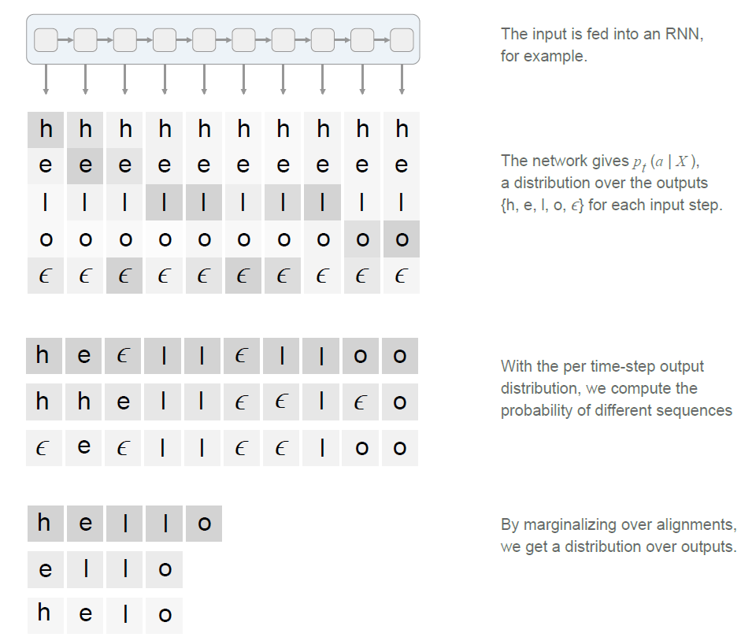

Slide 39
CTC algorithm
Beam search decoding
매 step마다 K-best context를 보존
K : beam-width
Context : Prefix
Label이 N개라면
매 step K x N개 path의 확률을 계산
확률의 크기 기반으로 K개만 보존

Slide 40
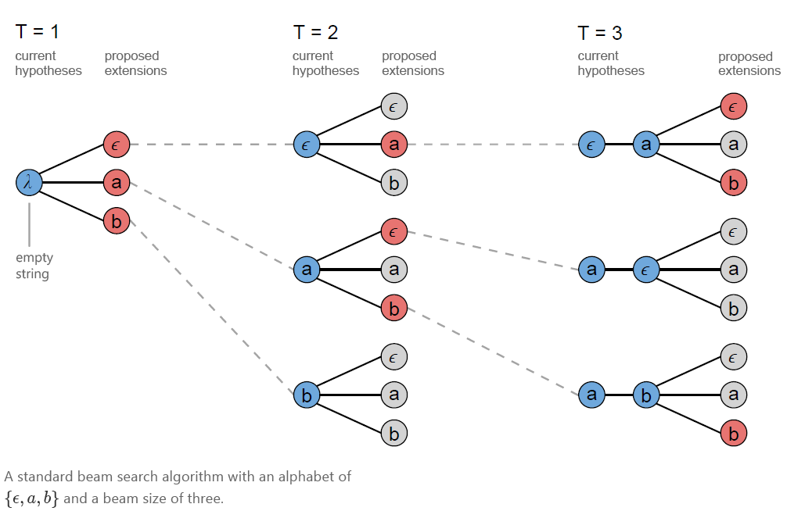
Beam Search Decoding

Slide 41
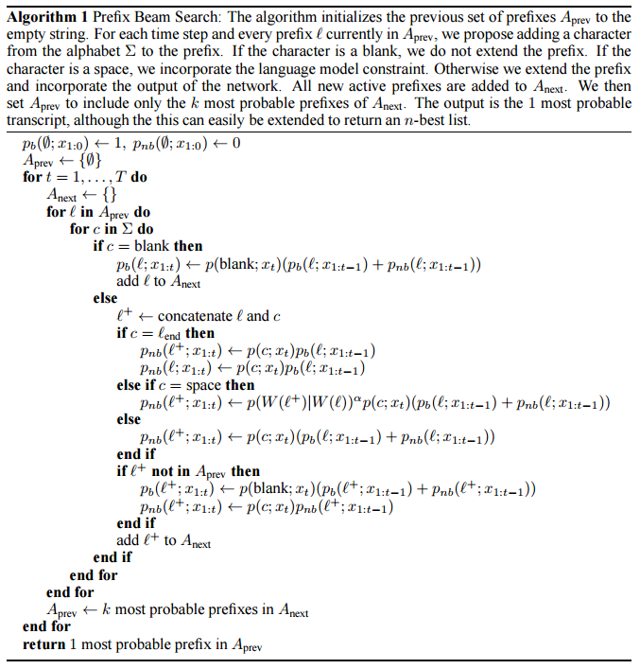
CTC algorithm
A
B
C
AA
AB
AC
…
A
AA
AB
AC
C
CA
…
A
B
C
//ab+b case
//ab_+b case
//ab+’ ‘ case
//ab+c case

Slide 42
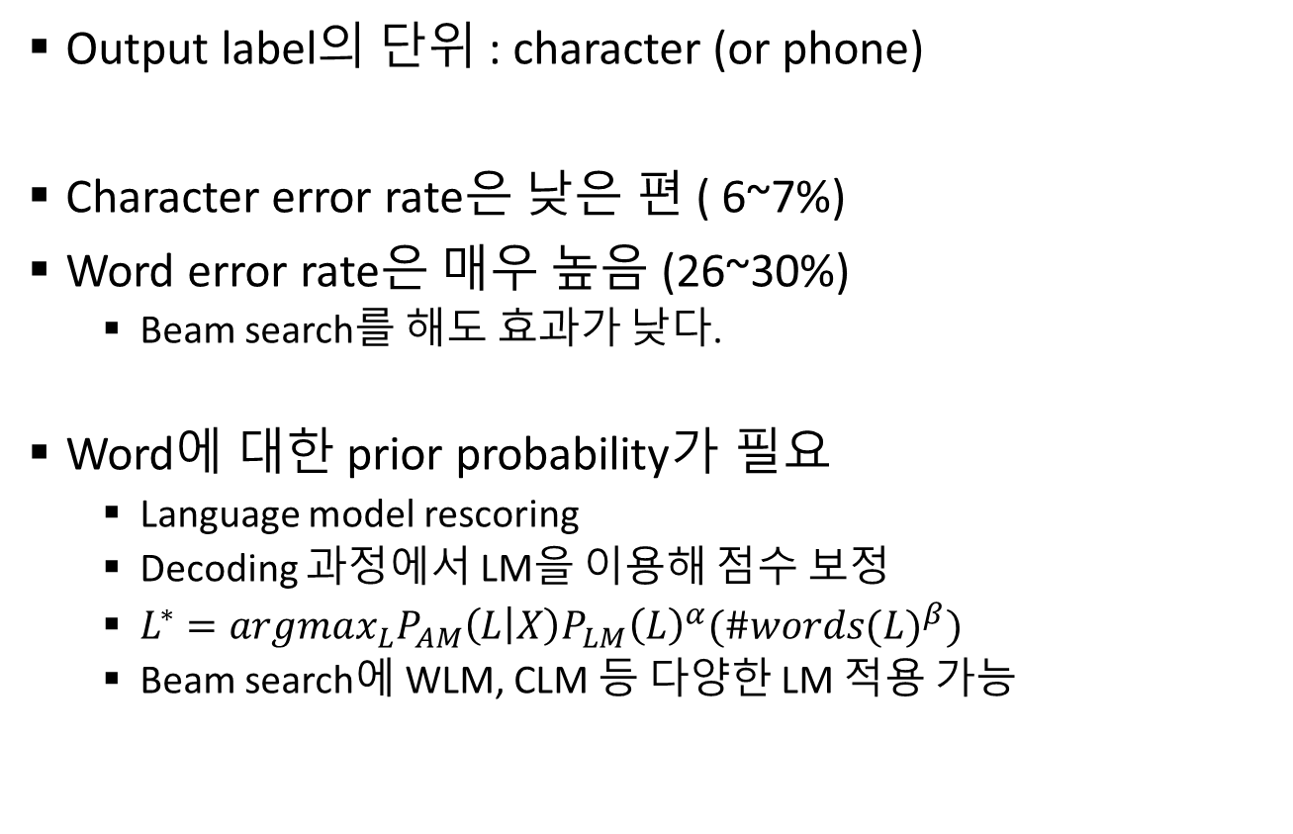
CTC Error 특성
Output label의 단위 : character (or phone)
Character error rate은 낮은 편 ( 6~7%)
Word error rate은 매우 높음 (26~30%)
Beam search를 해도 효과가 낮다.
Word에 대한 prior probability가 필요
Language model rescoring
Decoding 과정에서 LM을 이용해 점수 보정
$L^{∗}=argmax_{L}P_{AM}\left(L | X\right)P_{LM}{\left(L\right)}^{α}({\#words(L)}^{β})$
Beam search에 WLM, CLM 등 다양한 LM 적용 가능

Slide 43
CTC decoding with character language model(CLM)
Maas, Andrew L., et al. "Lexicon-Free Conversational Speech Recognition with Neural Networks." HLT-NAACL. 2015.
Hwang, Kyuyeon, and Wonyong Sung. "Character-level incremental speech recognition with recurrent neural networks." Acoustics, Speech and Signal Processing (ICASSP), 2016 IEEE International Conference on. IEEE, 2016.
CTC output is the probability distribution of characters (although there is word CTC output), thus it is more logical to incorporate CLM to filter out noisy CTC output
The decoding procedure is simpler than the WLM constrained CTC decoding (first-pass…)
CLM does not need a highly demanding softmax function
The CLM is applied every time step, while the WLM based approach only be applied when we consider adding a space or by computing the likelihood of a sequence being the prefix of a word in the lexicon<- (demand more computation!)
Can better handle OOV (the result does not care whether the word in in the lexicon or not)

Slide 46
Implementation Complexity
Acoustic RNN runs only once.
The character language model inference is needed for each beam and more frequently (compared to word-model).
The decoding complexity is proportional to the beam width.
Memory size: character language model

Slide 47
Tensorflow CTC-RNN
output
(100, 31)
Model
Input : (n_batch, n_seq, 40, 3)
Conv1(filter : 32, kernel : 3x3, stride = 2)
Conv2(same)
Reshape
Output : (n_batch, n_seq/4, 320)
4x unidirectional LSTM(512)
Dense(31)
Output : (n_batch, n_seq/4, 31)
BatchNorm after Conv
Dropout after LSTM
Dense
(100, 512)
4xLSTM
(100, 320)
reshape
(100, 10, 32)
Conv2
(400, 20, 32)
Conv1
Input
(800, 40, 3)

Slide 48
Part 2: CTC Implementation Examples

Slide 49
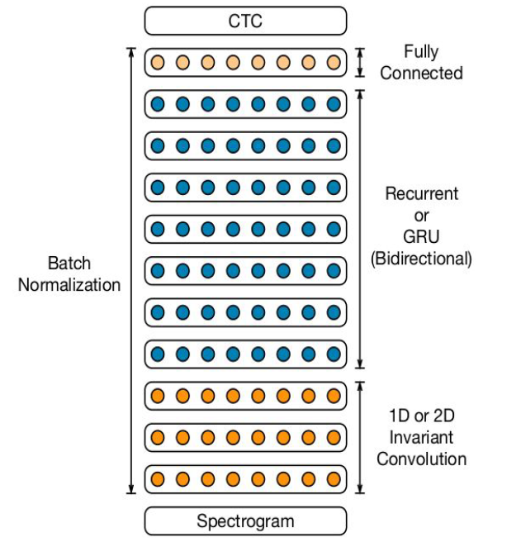
Deepspeech2
Baidu, ICML 2016
Spectrogram
CNN
RNN
Fully connected
CTC cost function

Slide 50
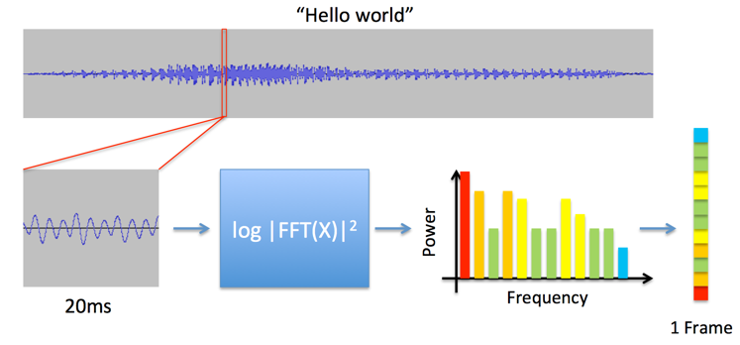
Spectrogram

Slide 51
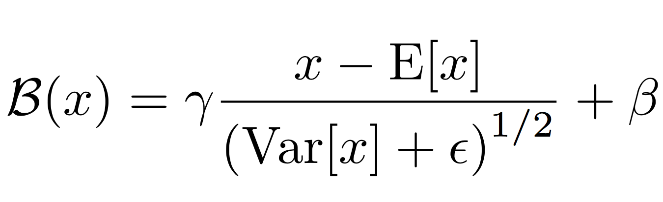
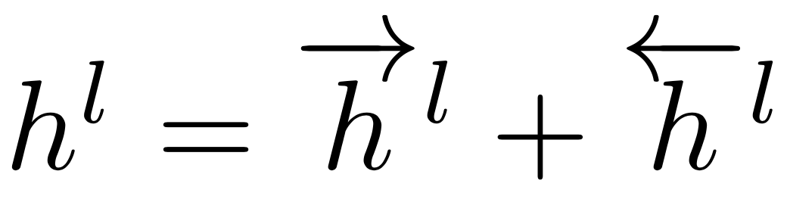
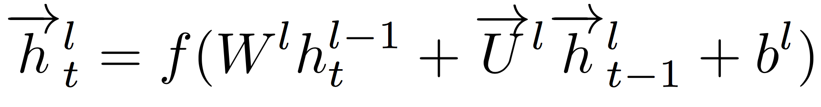
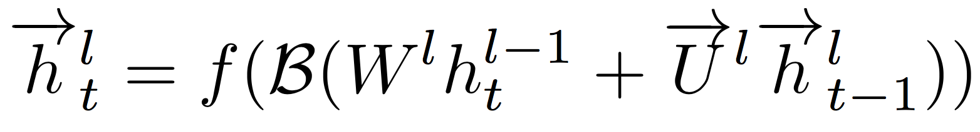
Batch Normalization
To efficiently scale the model as the training set is scaled
Increasing the depth of the network leads to optimization issues
BatchNorm accelerates the training for DNN
Basic formulation for RNN

Slide 52
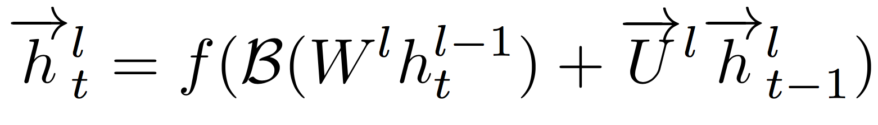
Deep Speech – Batch Norm for RNNs
Normalize
Normalize
Slides from Awni Hannun

Slide 53
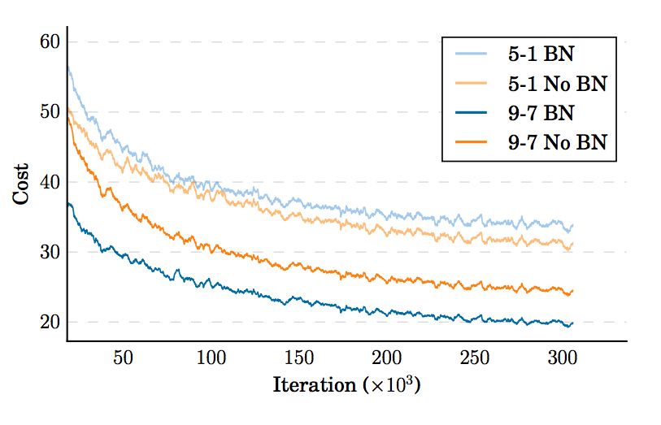
Deep Speech – Batch Norm for RNNs
Slides from Awni Hannun

Slide 54
Deep Speech - Hours of speech data
Language | Hours
English | 12,000
Mandarin | 10,000
Where does the data come from?
Public benchmarks (English)
Internal manually labelled data (English and Mandarin)
Captioned videos (English and Mandarin)
Slides from Awni Hannun

Slide 55
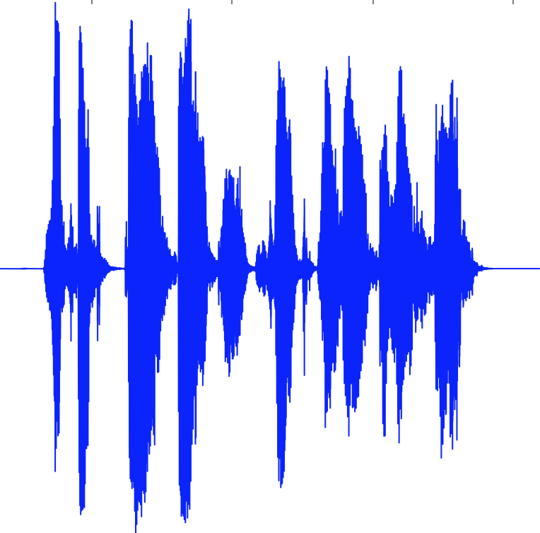
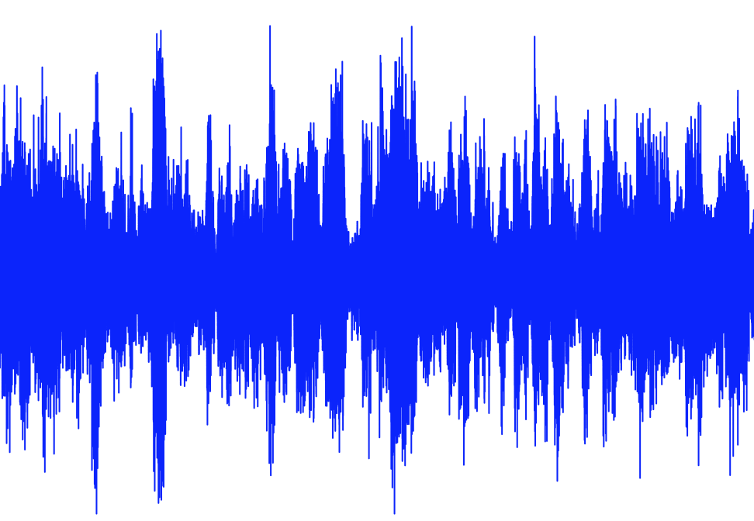
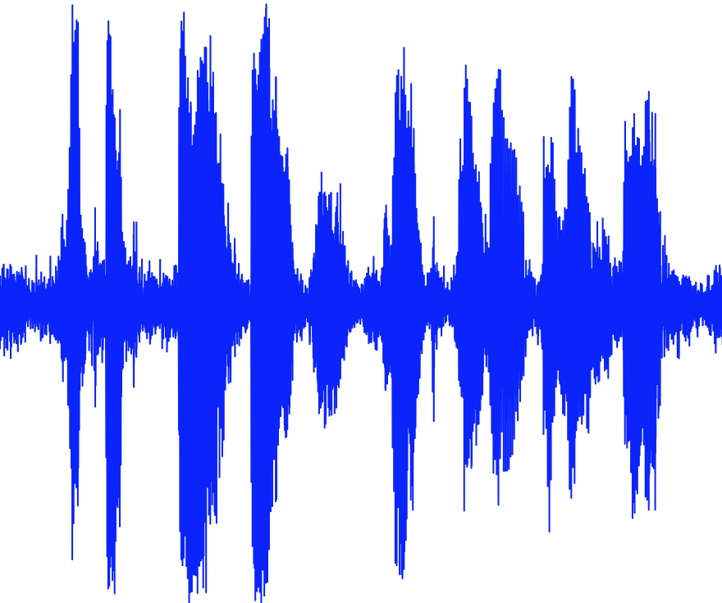
Deep Speech - Even more data!
Augmentation: noise synthesis, reverb, time-stretching, pitch-shifting,...
Speech
Noise
Noisy Speech
Slides from Awni Hannun

Slide 56
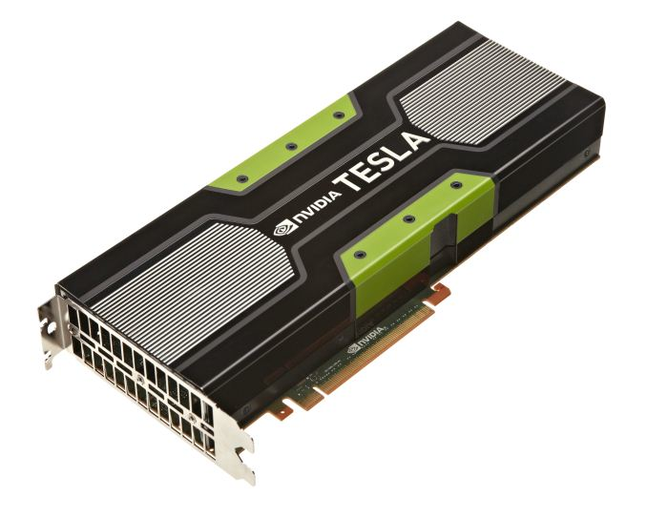
Deep Speech – Data Parallel GPU Scaling
Model 1
Model 2
Share weight updates each iteration
InfiniBand
Model 3
Model 4
Slides from Awni Hannun
Notes:
-when 1 gpu isn’t enough, lots of gpus

Slide 57
Deep Speech – Some results
Architecture | English (WER) | Mandarin (WER)
5-layer 1-RNN | 13.55 | 15.41
5-layer 3-RNN | 11.61 | 11.85
5-layer 3-RNN + BatchNorm | 10.56 | 9.39
9-layer 7-RNN + BatchNorm + Frequency Convolution | 9.52 | 7.93
Mandarin: 6000 output labels
Slides from Awni Hannun

Slide 58
Deep Speech – Deployment
Bi-directional models give almost 10% relative boost … but we can’t deploy them.
ASR latencies for voice search <50ms
For 3 second audio would need to decode 60x faster than realtime!
Slides from Awni Hannun

Slide 59
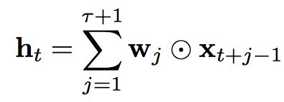
Deep Speech – Lookahead convolution
Slides from Awni Hannun

Slide 60
Deep Speech – Lookahead convolution
For a lookahead of 20 time-steps (about 800ms in the future)
Model | English (WER) | Chinese (WER)
Forward only | 18.8 | 15.7
Forward + Lookahead (+50k params) | 16.8 | 13.5
Bidirectional (+12M params) | 15.4 | 12.8
Slides from Awni Hannun
Notes:
custom MPI algorithm and description

Slide 61

SortaGrad
Training on examples of varying length pose some algorithmic challenges
Think of how a child learns
Longer examples tend to be more challenging
1st epoch : iterate through the training set in increasing order of the length of the longest utterance in the minibatch
Other epochs : the training reverts back to a random order over minibatches

Slide 62
LM based Decoding
Beam search decoding with 5-gram LM
Parameters tuned to EV set

Slide 63

GPU Implementations
Memory allocation issue
Most of it is for activations through each layer for use by back propagation
70M parameters: “only” 280 MB of memory for the weights but for the activations with a batch of 64 and seven-second utterances it is 1.5 GB...
Leads to parallel SGD
Also allocate to CPU memory accessible by the GPU

Slide 64

Effects of Data Size

Slide 65
Scaling Up
LibriSpeech - clean 100h
Big variance of WER depending on batch size
batch size = 75 (max): WER = 58%
batch size = 40 : WER = 52%
batch size = 12 : WER = 42%
Tradeoff: faster training vs lower WER
Explanation: noisy gradients
LibriSpeech - clean ~1000h (full training dataset)
Audio files: 60 GB - almost 300k utterances
Input data to network: 212 GB
Batch size 64
One epoch took ~8h
Whole training over a week
WER ~12%
Baidu got 5.33%

Slide 66
Soltau, Hagen, Hank Liao, and Hasim Sak. "Neural speech recognizer: Acoustic-to-word LSTM model for large vocabulary speech recognition." arXiv preprint arXiv:1610.09975 (2016).

Slide 67
100,000 words
125,000 hours of semi-supervised acoustic training data.

Slide 68


Slide 69


Slide 70


Slide 71



Slide 72


Slide 73
FPGA implementation
LSTM RNN operations occupy most of the computation.
We assign system resource at best by implementing them on the PL block.
Hypothesis search is conducted on the PS block (ARM CPU).

Slide 74
FPGA implementation
Fixed-point optimization (retraining-based) applied
Bit-width for weights: 4 ~ 6 bits
Bit-width for LSTM memory: 16 bits
The LSTM block computes the matrix-vector multiplication in parallel.
The results are stored in PE buffer for later use.
Other parts of the LSTM equation are implemented on the LSTM EPU.

Slide 75
FPGA implementation results
RNN for AM + RNN for CLM
Small RNN: 3x256 RNN AM and 2x256 C-LM RNN (implemented on Xilinx XC7Z045)
Large RNN: 4x512 RNN AM and 4x512 C-LM RNN (implemented on Xilinx XCVU190)
Small RNN needs about 7MHz for real-time, consuming about 5.5 W (less than 1W for each person). Large RNN consumes about 11.8W

Slide 76
Low-power, on-device, speech recognition is possible with HMM-free, neural network based algorithms
Neural networks can be implemented efficiently by employing many PU’s (processing units)
Fixed-point quantization and on-chip memory based operations
RNN based speech recognition algorithm.
RNN based AM and hierarchical LM are employed.
Can deal with both character- and word-level characteristics.
Low complexity input and output (alphabet size, not word size)
The parameter size is very small (2.3 M ~ 15.1 M weights), thus it can be implemented without using DRAM accesses.
FPGA implementation of the algorithm.
About 7MHz clock is needed for real-time operation with 128 beam size (more than 10 times speed-up with 100MHz clock)

Slide 77
End-to-end 연구 개발의 문제
Accuracy (WER): 많은 데이터를 동원하면 기존 (HMM 기반) 과 필적, 또는 더 나아진다. Data!
훈련을 위한 efficient computing: multi-GPU, pretraining 등 Acoustic model training 매우 느리다 (weeks)
Decoding: 많은 경우 외부 LM등을 이용하여 decoding 을 해야 한다. Beam-search 시 width 에 비례해서 LM 계산이 증가한다. 이를 어떻게 줄이나.
On-line service 문제: bi-directional RNN 또는 LAS (Listen Attend Spell)이 uni-directional RNN 기반보다 성능이 좋다. 그러나 latency 문제
희망: 위의 모든 문제가 2~3년 내에 풀릴 것이다. 기존의 HMM 기반보다 더 효율적인 ASR 가능.

Slide 78
Some slides sources:
End to end automatic speech recognition http://llcao.net/cu-deeplearning17/lecture/lecture6_Markus.pdf
(CTC algorithm illustration) https://distill.pub/2017/ctc/
(Deepspeech2) End-to-end speech recognition system using RNNs and the CTC loss function: http://www.zhoutengyu.com/ppt/DeepSpeech.pptx?WebShieldSessionVerify=YNWYPZrjOFbUvSXiSgvN

Slide 79
중요논문
Sequence Transduction with Recurrent Neural Networks A Graves, 2012
Towards End-to-End Speech Recognition with Recurrent Neural Networks Graves Jaitly 2014
EESEN: END-TO-END SPEECH RECOGNITION USING DEEP RNN MODELS AND Y Miao 2015
Neural Speech Recognizer: Acoustic-to-Word LSTM Model for Large Vocabulary Speech Recognition H Soltau, Hasim Sak 2016
Comparison of decoding strategies for CTC acoustic models CMU, Karlsruhe
Amodei, Dario, et al. "Deep speech 2: End-to-end speech recognition in english and mandarin." International Conference on Machine Learning. 2016.
Lee, Minjae, et al. "FPGA-based low-power speech recognition with recurrent neural networks." Signal Processing Systems (SiPS), 2016 IEEE International Workshop on. IEEE, 2016.
Hwang, Kyuyeon, and Wonyong Sung. "Sequence to sequence training of ctc-rnns with partial windowing." International Conference on Machine Learning. 2016.
Hwang, Kyuyeon, and Wonyong Sung. "Character-level incremental speech recognition with recurrent neural networks." Acoustics, Speech and Signal Processing (ICASSP), 2016 IEEE International Conference on. IEEE, 2016.

